Slide 1


TRAVEL TIME
PREDICTION
Presented by:
Vinay Kumar – Roll No: 12
2. Ganesh – Roll No: 21
3. Chiranjeevi – Roll No: 06

Slide 2

Introduction
Travel time prediction is a crucial component of modern cabs, logistic delivery system, flights, trains, emergency systems, transportation systems, enabling efficient planning and optimization of routes from point AtoB, schedules, and resources. By leveraging machine learning techniques, Our travel Time Prediction project aim is to predict the amount of time, a taxi trip will take, based on various features such as pickup and dropoff locations, time of day, and weather conditions.
These predictive models not only consider historical travel data but also incorporate real-time factors such as traffic congestion, accidents, and weather conditions. Through sophisticated algorithms, they can analyze vast amounts of information to generate predictions that account for the dynamic nature of transportation networks. This adaptability is essential for providing reliable estimates in constantly changing environments.

Slide 3
Importance of Accurate Travel Time Prediction
Informed Decision Making (Time Value)
Reduced Congestion
Precise travel time estimates allow commuters, logistics companies, and transportation agencies to make more informed decisions and optimize their routes. (PHG🚂-DEL🛫-HYD)
Accurate predictions can help alleviate traffic congestion by providing real-time updates and alternate route suggestions to drivers.
Improved Reliability (No waiting time)
Cost Savings (Fuel)
Travelers can better plan their schedules and arrive at their destinations on time with reliable travel time forecasts.
Precise predictions can lead to fuel savings, reduced vehicle maintenance costs, and more efficient logistics for businesses and individuals.

Slide 4

Challenges and Factors Affecting Travel Time
Urban Traffic Congestion
1
The volume of vehicles on the road significantly impacts travel time, with high traffics leads to longer delays.
2
Weather Conditions
Adverse weather, such as heavy rain, snow, or fog, can reduce visibility and traction, slowing down traffic and increasing travel time.
Roadway Infrastructure
3
Factors like the number of lanes, the presence of traffic signals, and the quality of the road surface can all influence travel time.

Slide 5



Data Sources for Travel Time Prediction
GPS Data
Traffic Cameras
Transportation Data
(at how many stations the train is waiting) make impact in your journey
Real-time GPS data from smartphones and connected vehicles provides detailed information on vehicle locations and speeds, enabling accurate travel time estimation.
Footage from roadside traffic cameras can be analyzed to detect vehicle movement and extract travel time data along specific routes.
Schedule and real-time data from transportation systems, such as buses and trains, can be used to predict travel times for commuters.

Slide 6
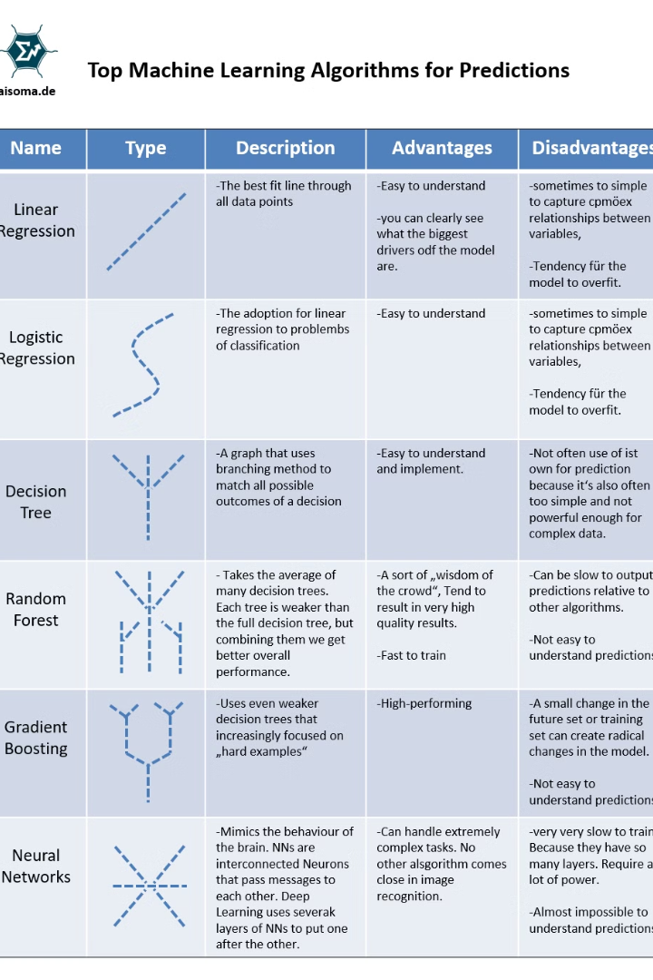
Machine Learning Techniques for Travel Time Prediction(classifiers)
A variety of machine learning techniques can be applied to the problem of travel time prediction. These include supervised learning methods like regression and classification, as well as unsupervised techniques like clustering (group of similar patterns) and dimensionality reduction (key feature from data).
The choice of algorithm depends on factors like data availability, desired prediction outputs.

Slide 7
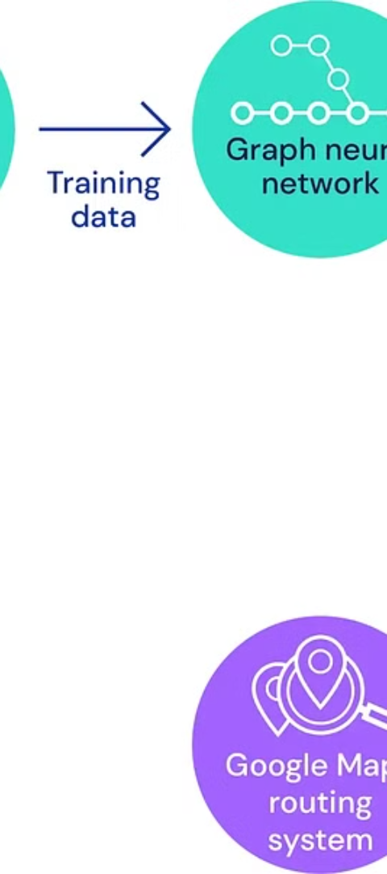



Supervised Learning Approaches
(Supervised learning is often preferred in machine learning because it provides a clear and structured way to teach algorithms to make predictions)
Linear Regression (predicts the value of unknown data using known)
Predicts travel time as a linear function of input variables like distance, traffic conditions, and historical patterns.
Random Forests (combines multiple decision trees to give single result)
Ensemble of decision trees that capture complex, nonlinear relationships in the data to make accurate predictions.
Decision Tree (tree like structure to show decisions and possible result)
A decision tree in machine learning is like a flowchart that learns to make decisions by splitting data into smaller subsets based on conditions.

Slide 8

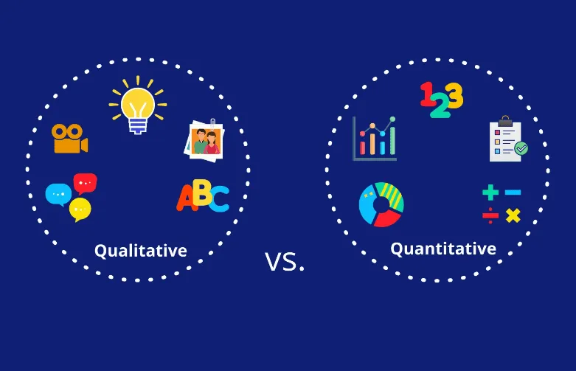
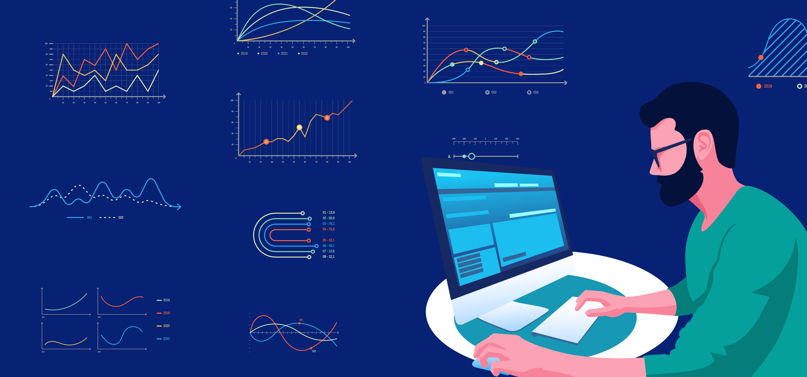

Methodology
Data Collection and Preprocessing
Evaluating Collected Data
Model Selection (considering efficiency)
Model Evaluation and Validation (training the model)
Gather data from various sources, to create a comprehensive dataset prediction model.
Identify and extract relevant features from the data, such as time of day, day of week, weather conditions.
Choose appropriate machine learning algorithms, such as linear regression, Random Forests etc.
Split the dataset into training and validation sets and use the training set to fit the selected machine learning models.

Slide 9
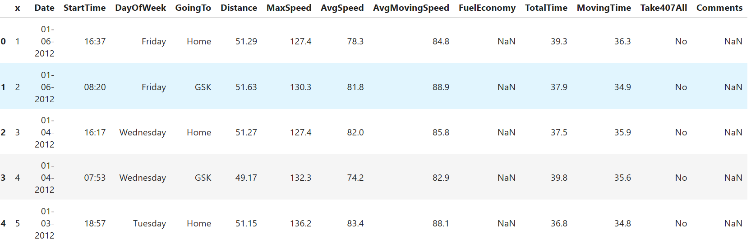
Result
Only Random Forest has least errors, therefore it can be considered as good algorithm for training our model. These are the results of the model. The below shown are the taxi total travel time on different dates of various times with distance, fuel economy, average and maximum speeds.
Validation Metrics
Description
Mean Absolute Error (MAE)
Measures the average absolute difference between predicted and actual travel times.
Root Mean Squared Error (RMSE)
Captures the overall magnitude of the errors, giving more weight to larger deviations.
Coefficient of Determination (R²)
Evaluates the proportion of the variance in the target variable that is predictable from the model.

Slide 10
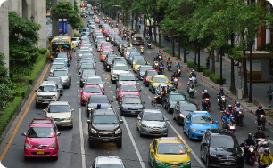



Real-World Applications of Travel Time Prediction
Traffic Management
Logistics and Delivery
Public Transit Planning
Emergency Response
Travel time prediction helps urban planners and traffic authorities identify congestion hotspots and optimize traffic flow, reducing delays and improving commuter experiences.
Accurate travel time forecasting enables logistics companies to plan more efficient delivery routes, manage driver schedules, and provide customers with reliable delivery estimates.
Travel time prediction models help public transit agencies optimize schedules, reduce wait times, and provide passengers with real-time arrival information for buses, trains, and other.
Predictive travel times allow first responders like police, fire departments, and ambulances to choose the fastest routes to incidents, improving response times and saving lives.

Slide 11


Conclusion
Summarizing the key points and insights gained from evaluating travel time prediction models. Utilizing error measures like MAE and RMSE, along with cross-validation techniques, ensures model generalization and refinement. These evaluations guide the optimization of travel time prediction models for real-world applications and future challenges.

Slide 12

Thankyou

